Slide 1
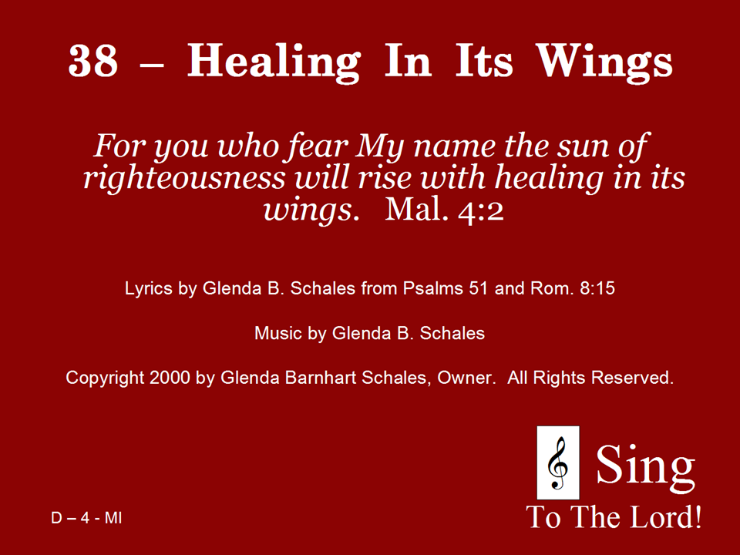
038 - Healing In Its Wings - Title

Slide 2
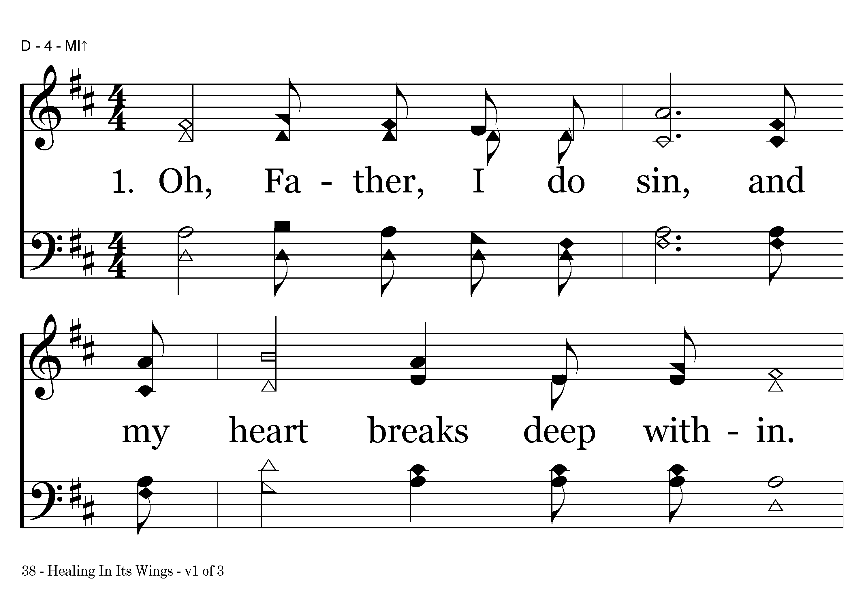
038 - Healing In Its Wings - 1.1

Slide 3
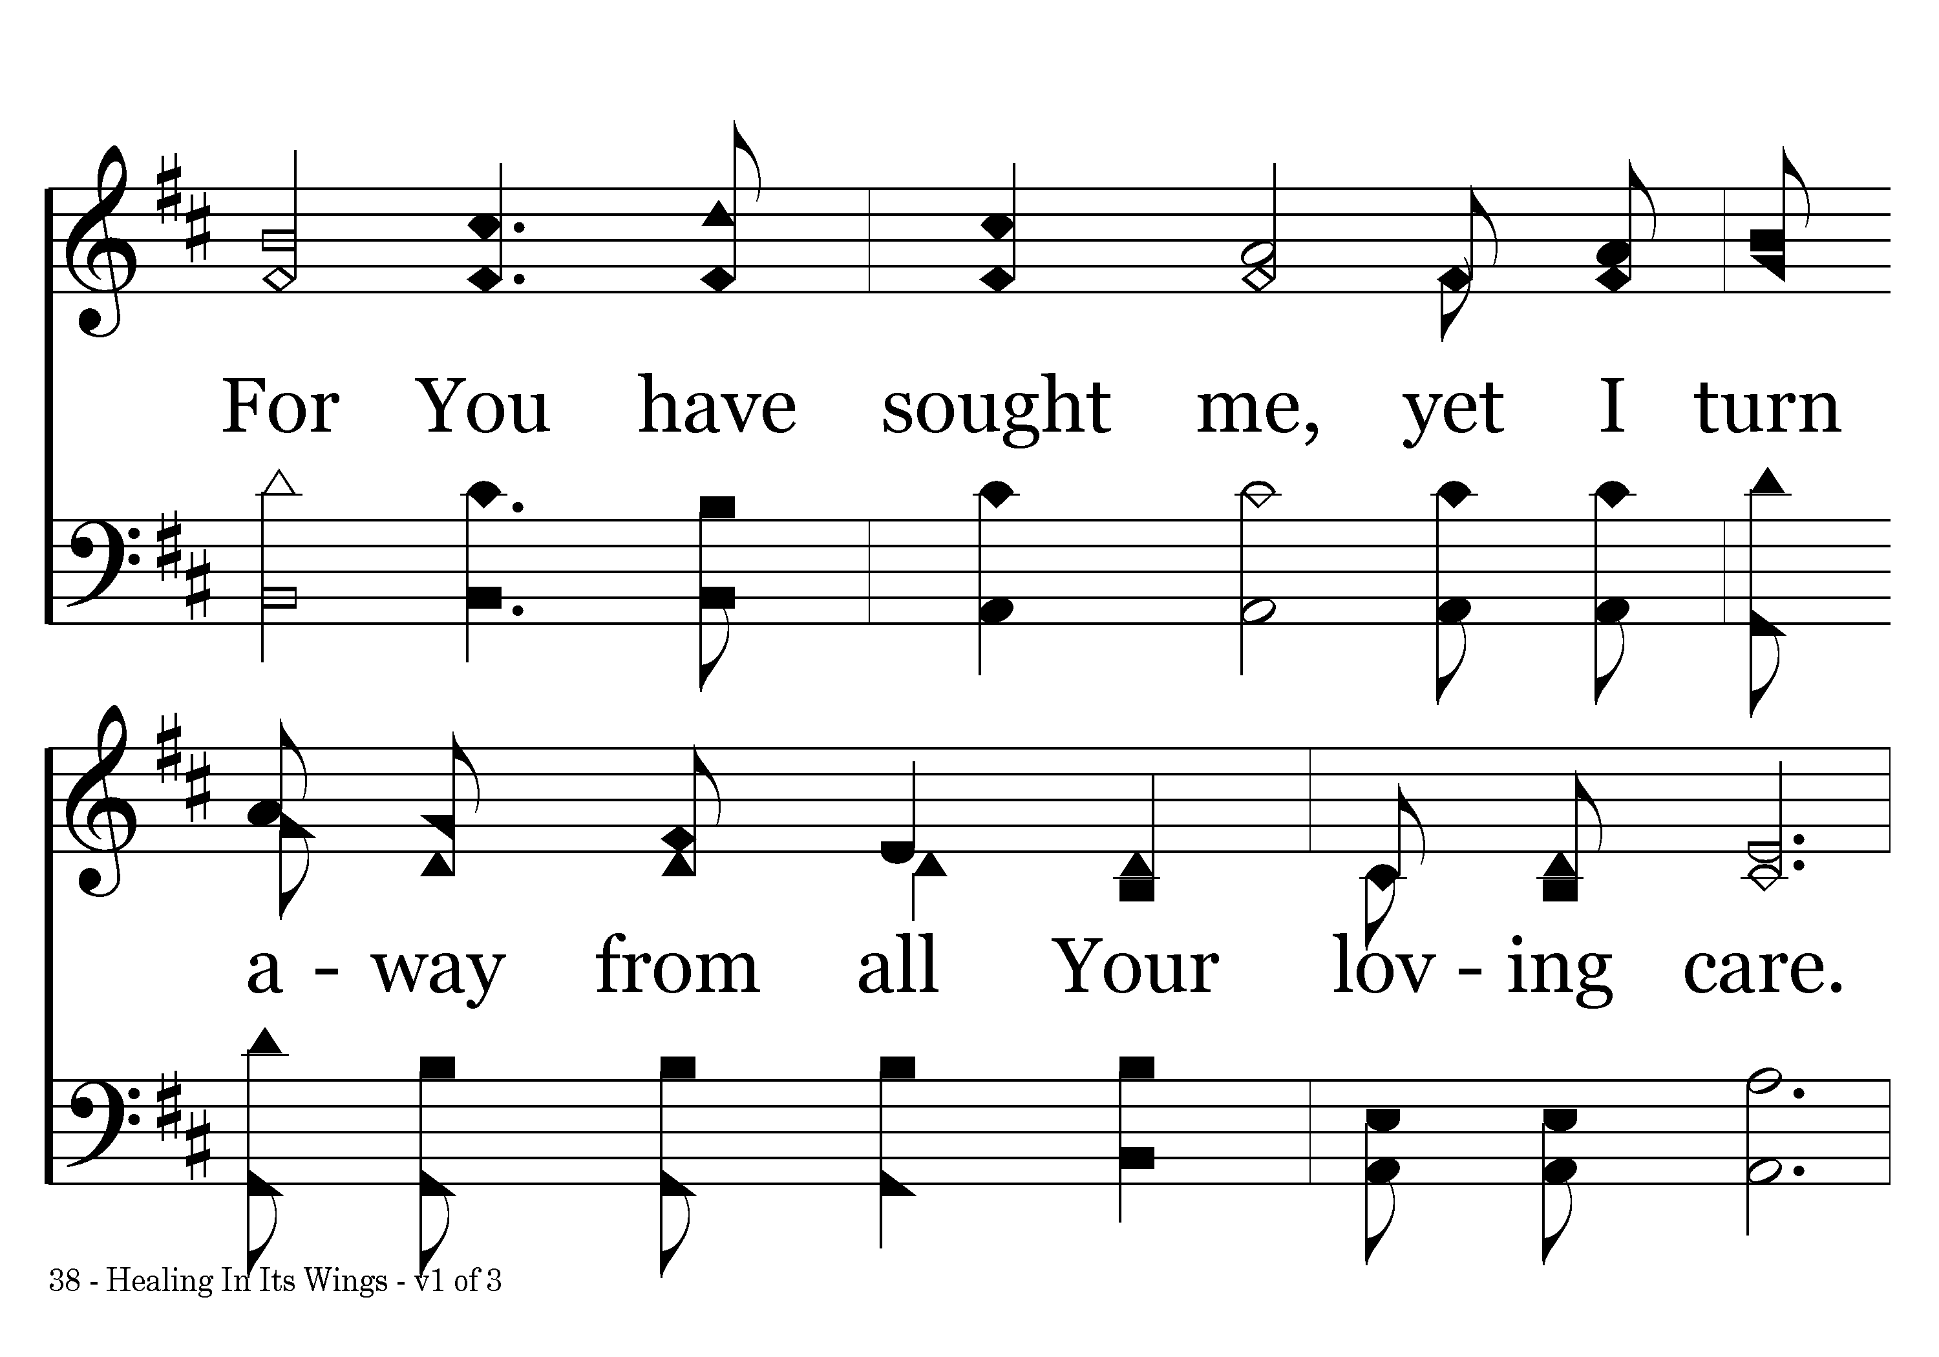
038 - Healing In Its Wings - 1.2

Slide 4
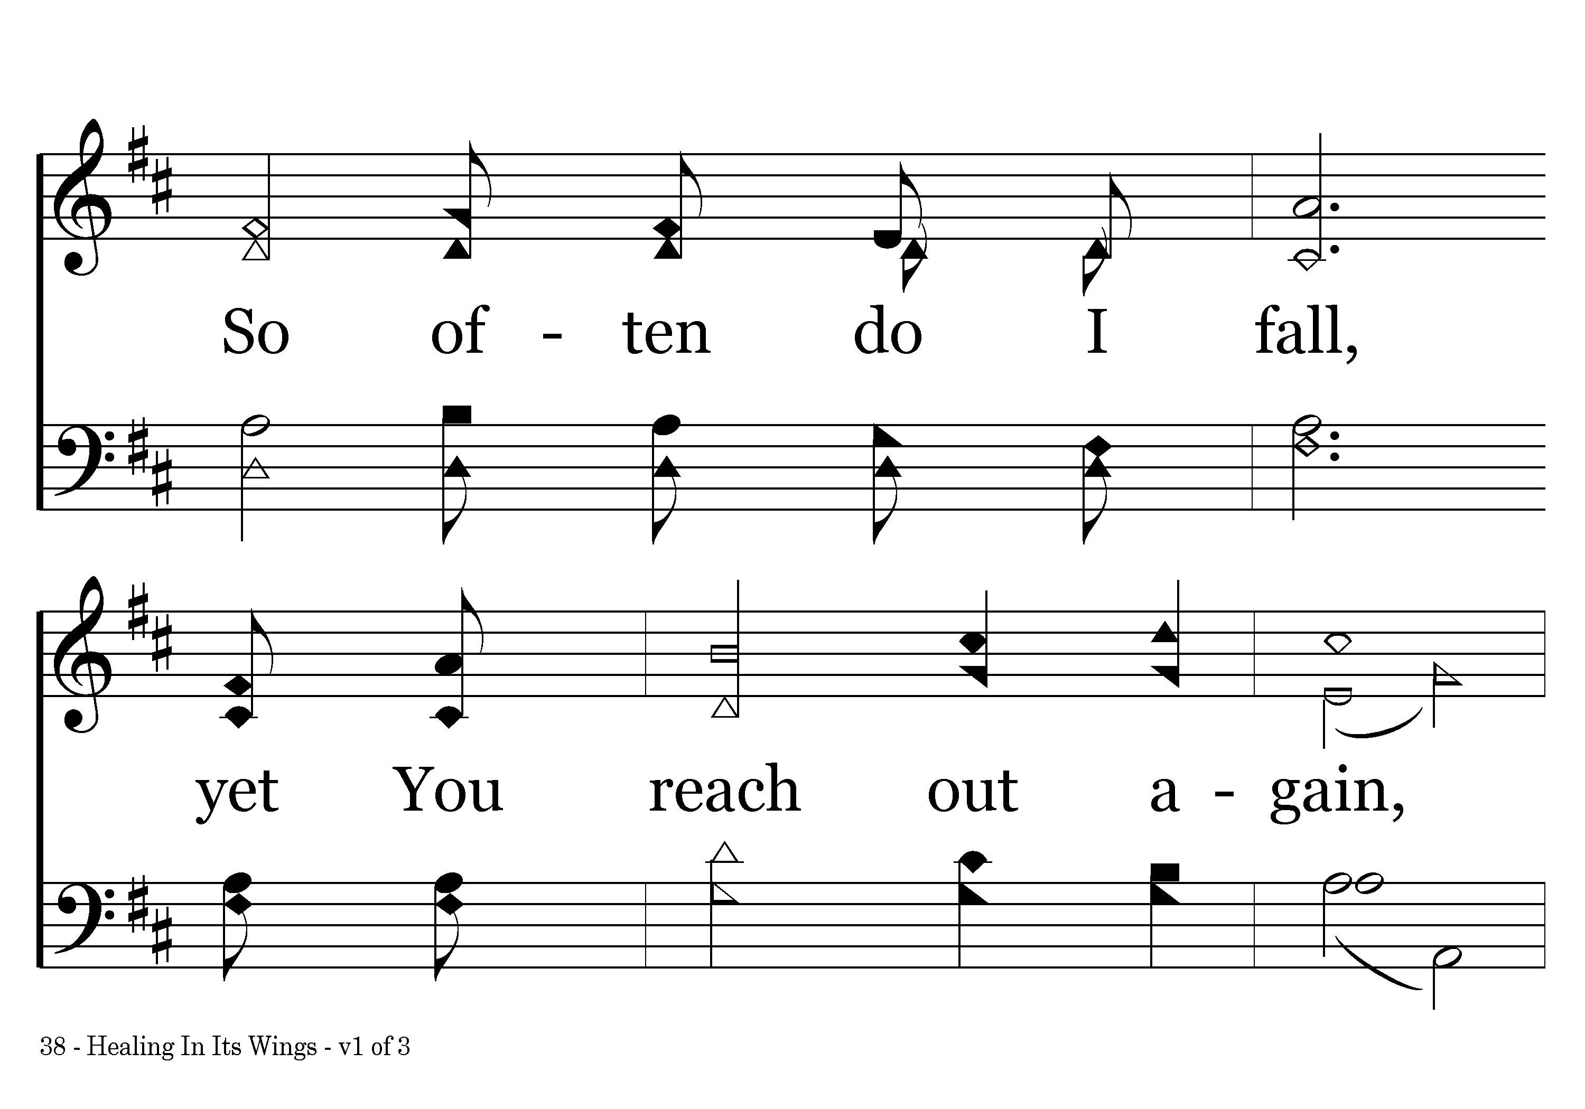
038 - Healing In Its Wings - 1.3

Slide 5
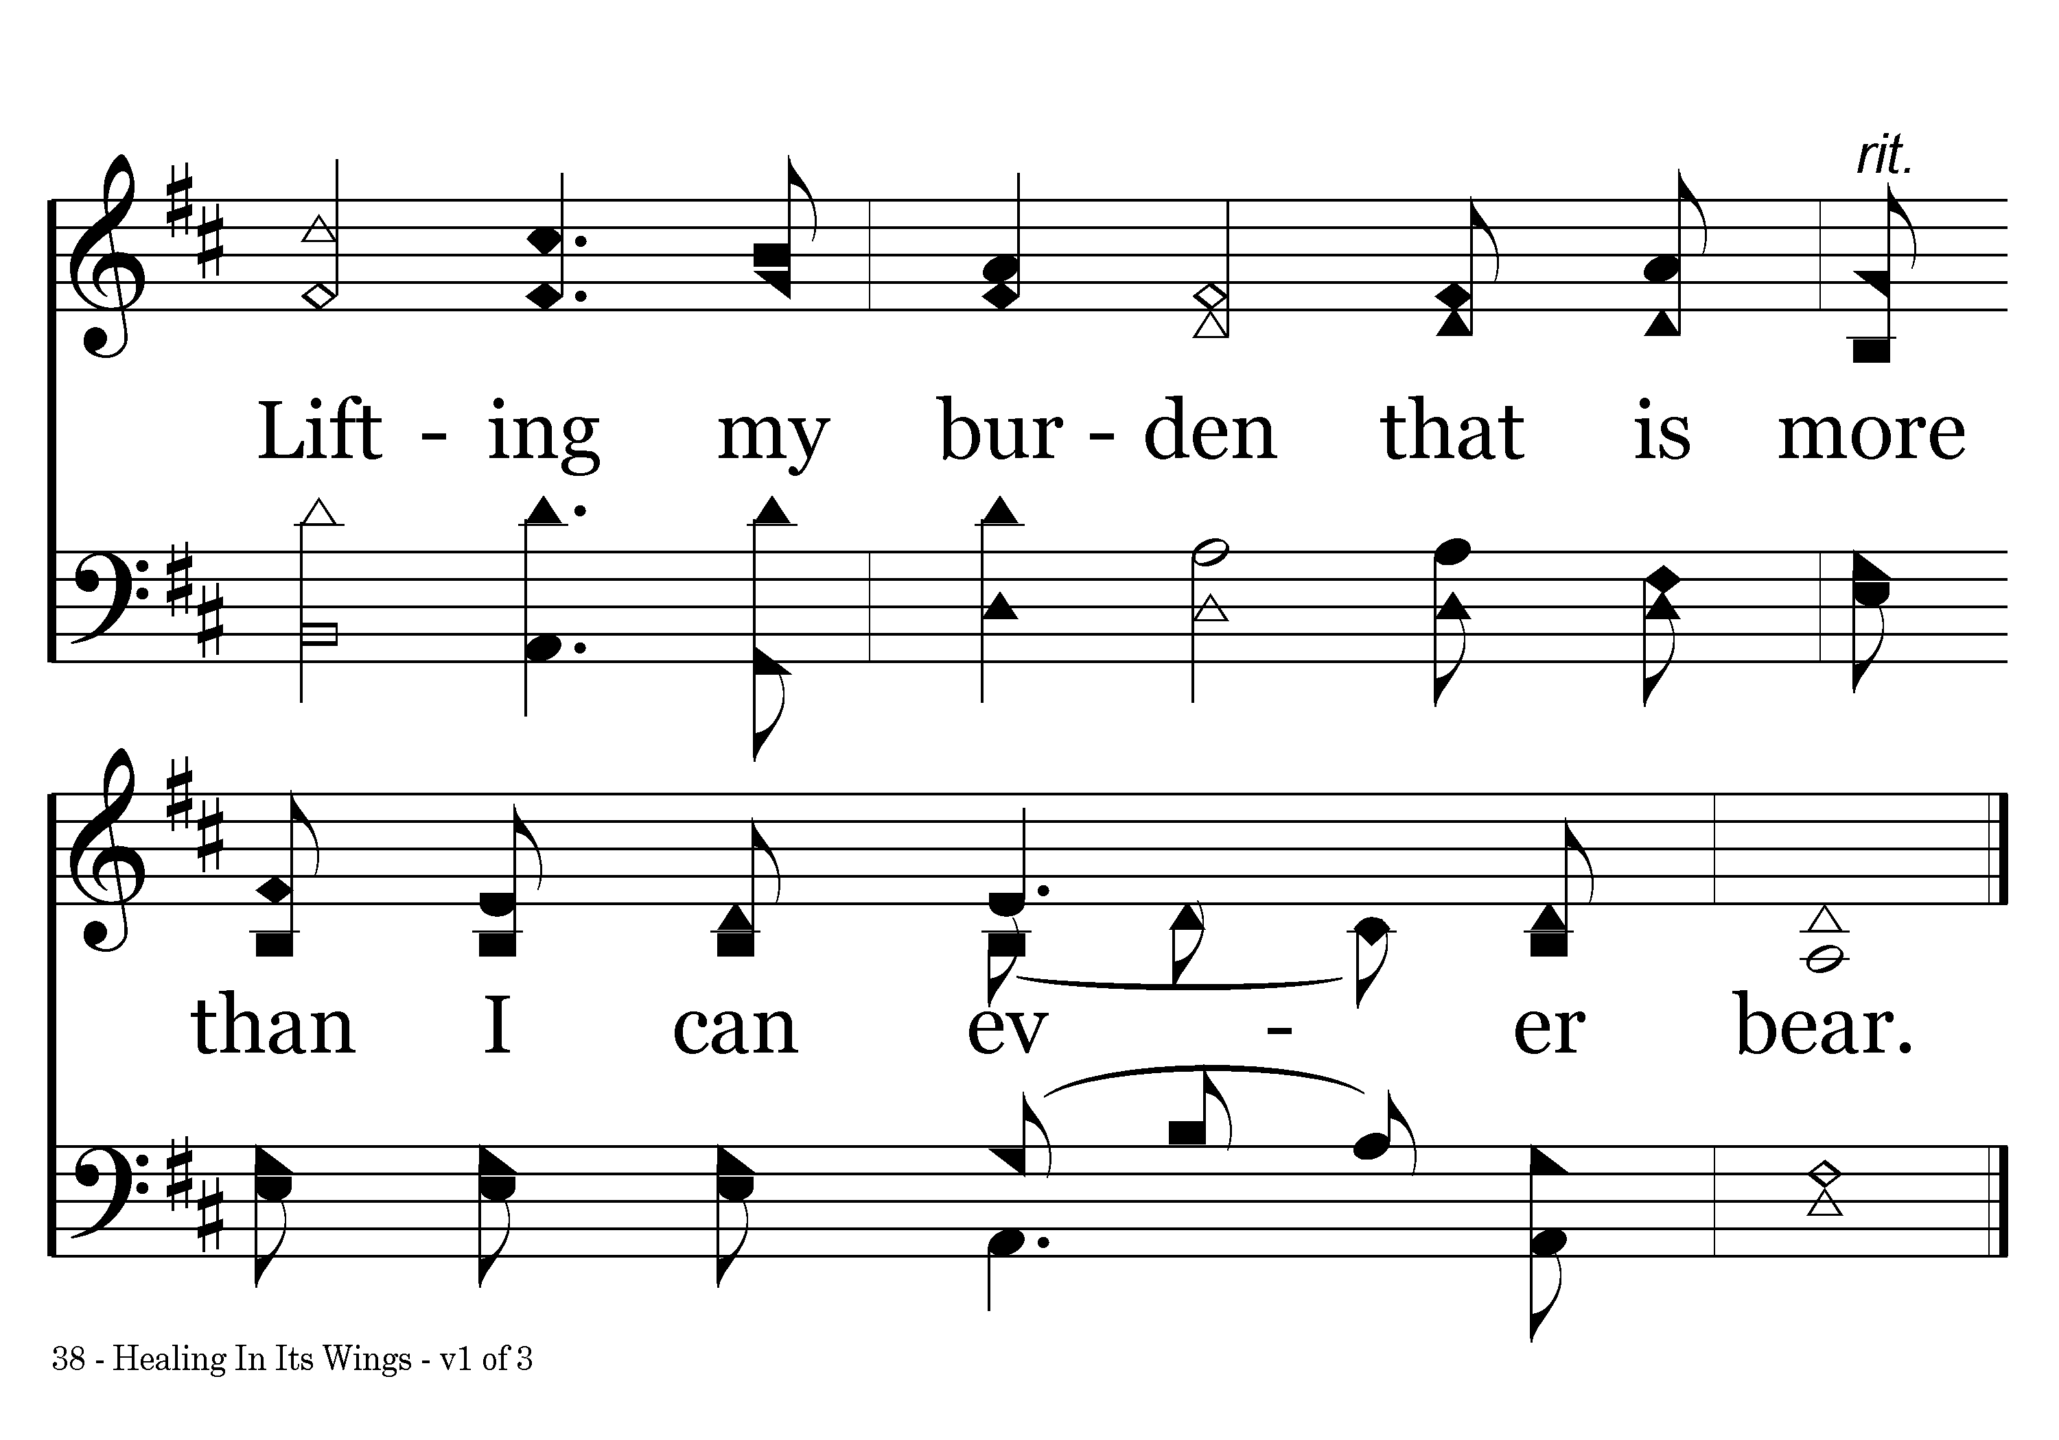
038 - Healing In Its Wings - 1.4
End of Verse 1

Slide 6
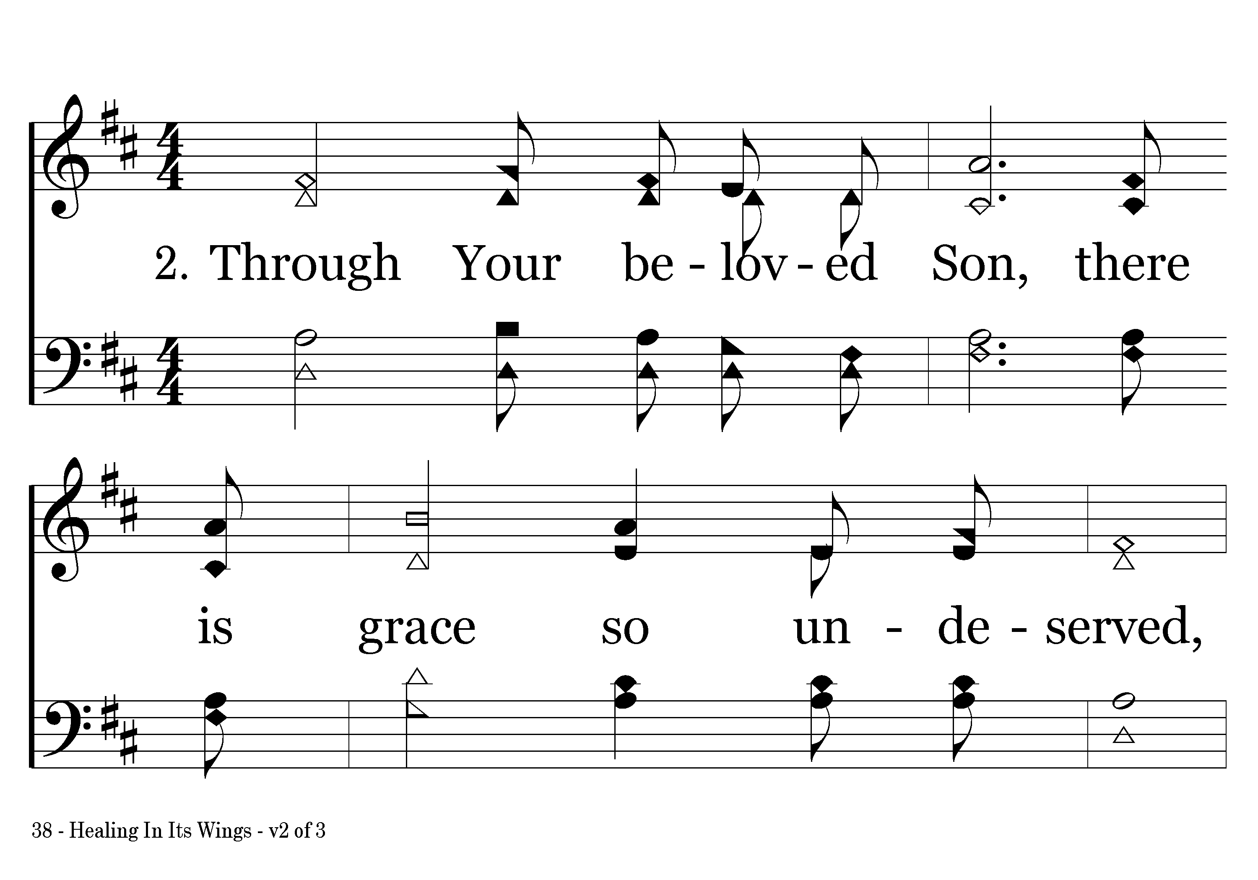
038 - Healing In Its Wings - 2.1

Slide 7
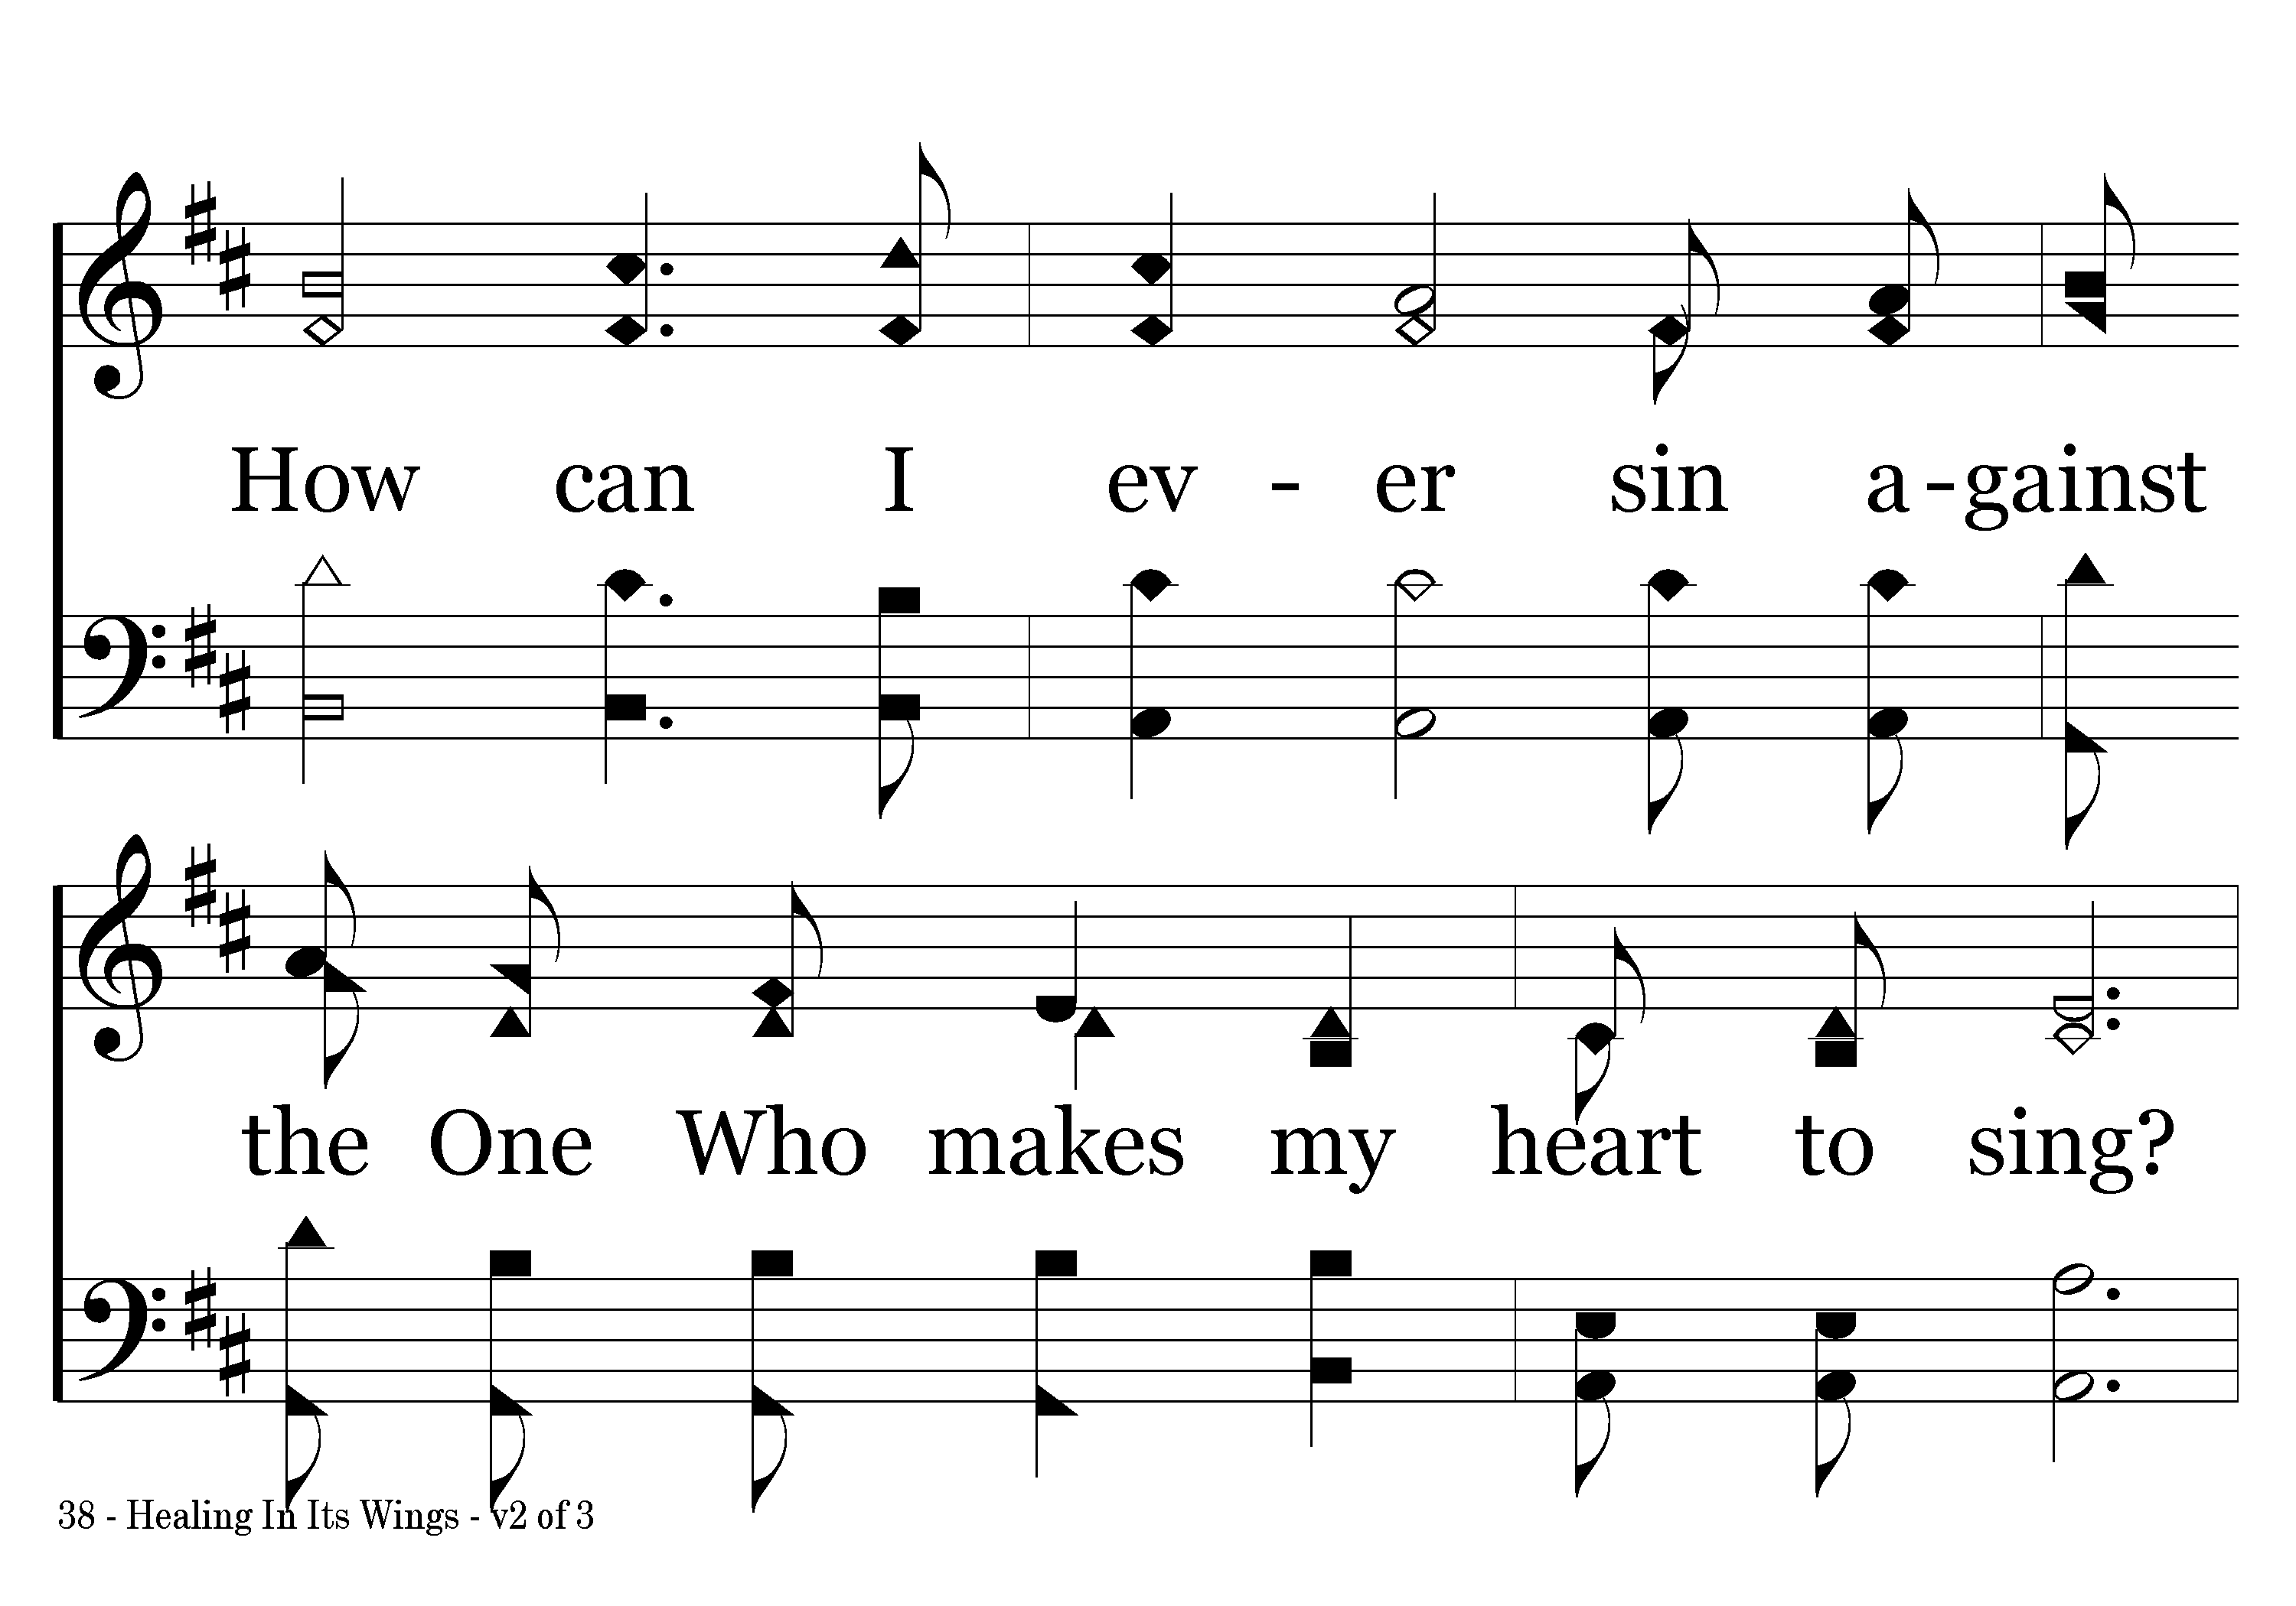
038 - Healing In Its Wings - 2.2

Slide 8
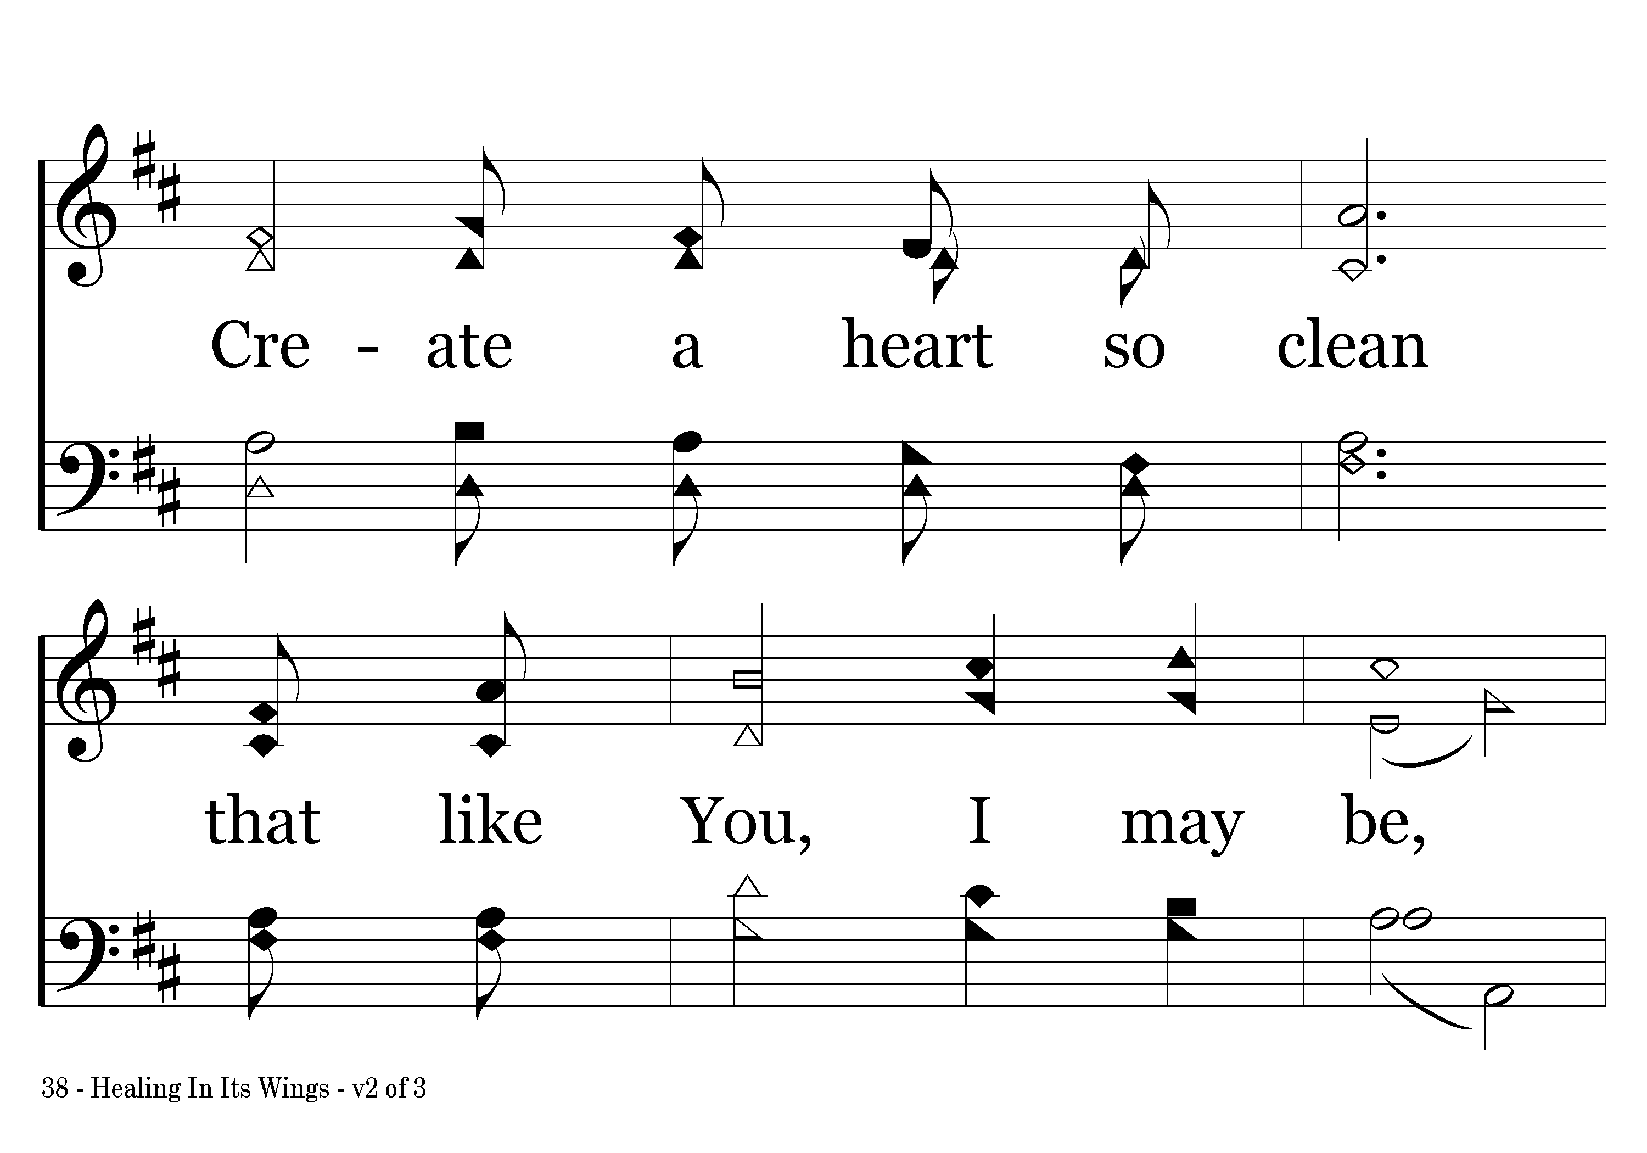
038 - Healing In Its Wings - 2.3

Slide 9
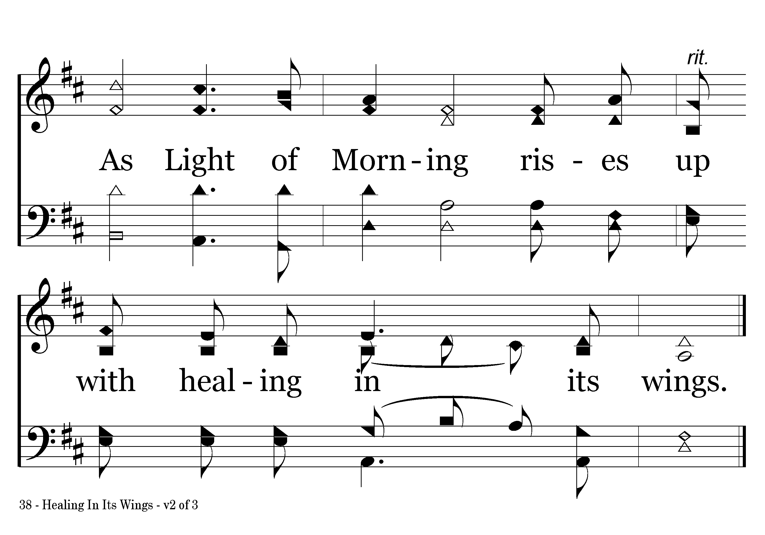
038 - Healing In Its Wings - 2.4
End of Verse 2

Slide 10
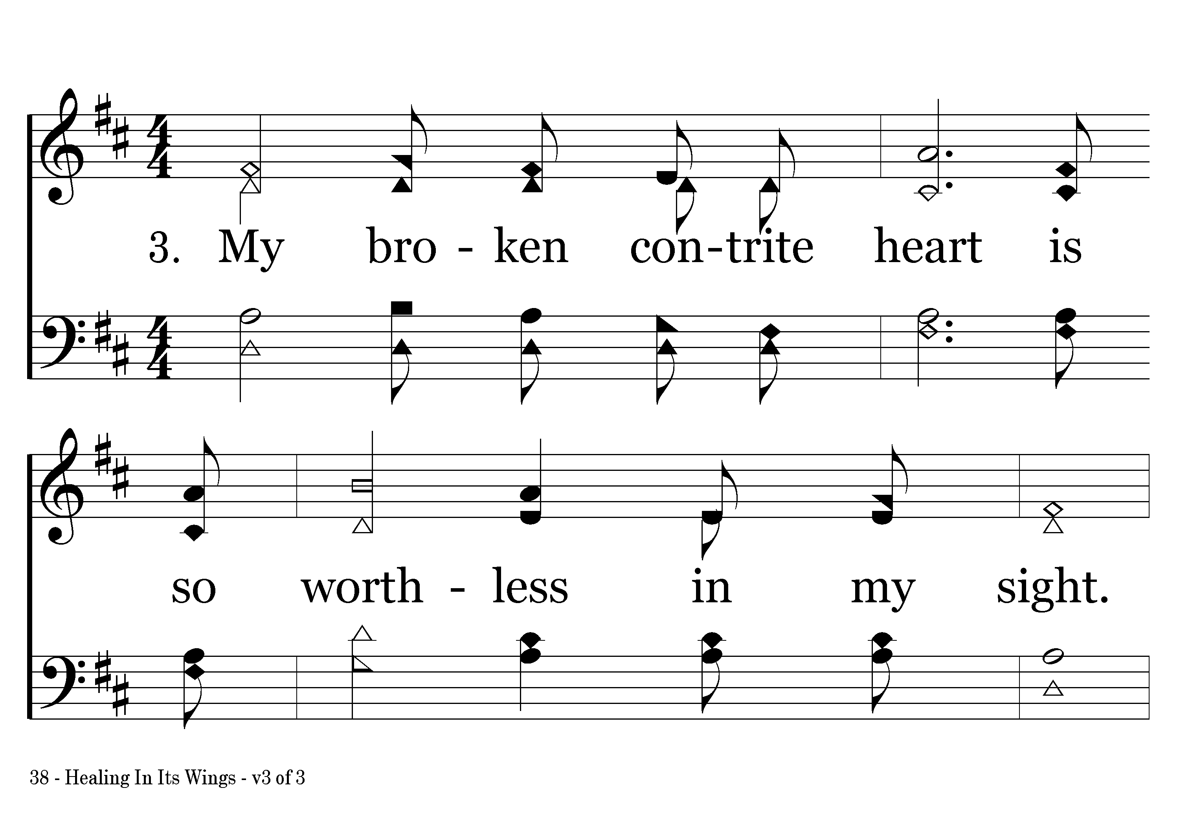
038 - Healing In Its Wings - 3.1

Slide 11
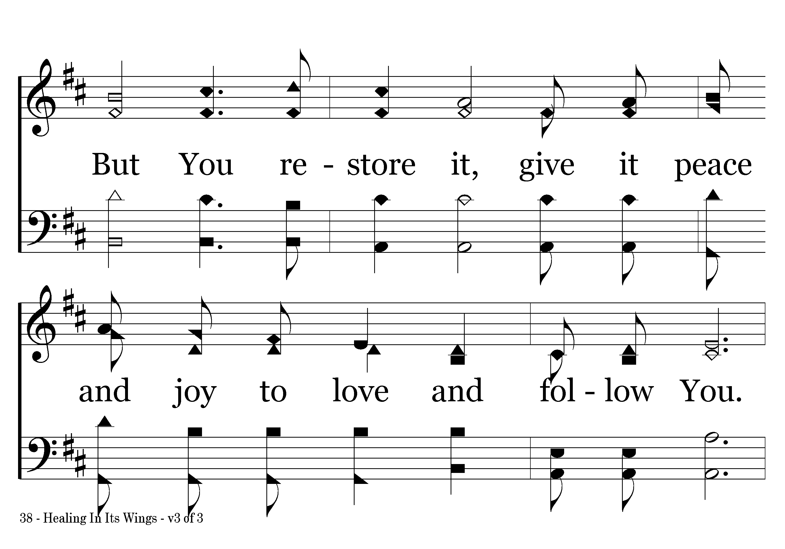
038 - Healing In Its Wings - 3.2

Slide 12
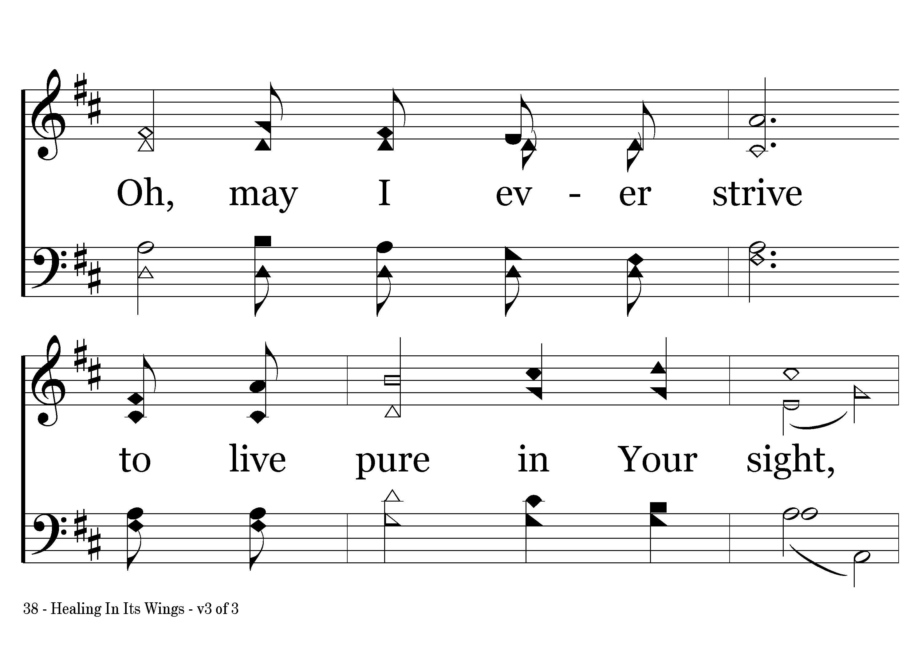
038 - Healing In Its Wings - 3.3

Slide 13
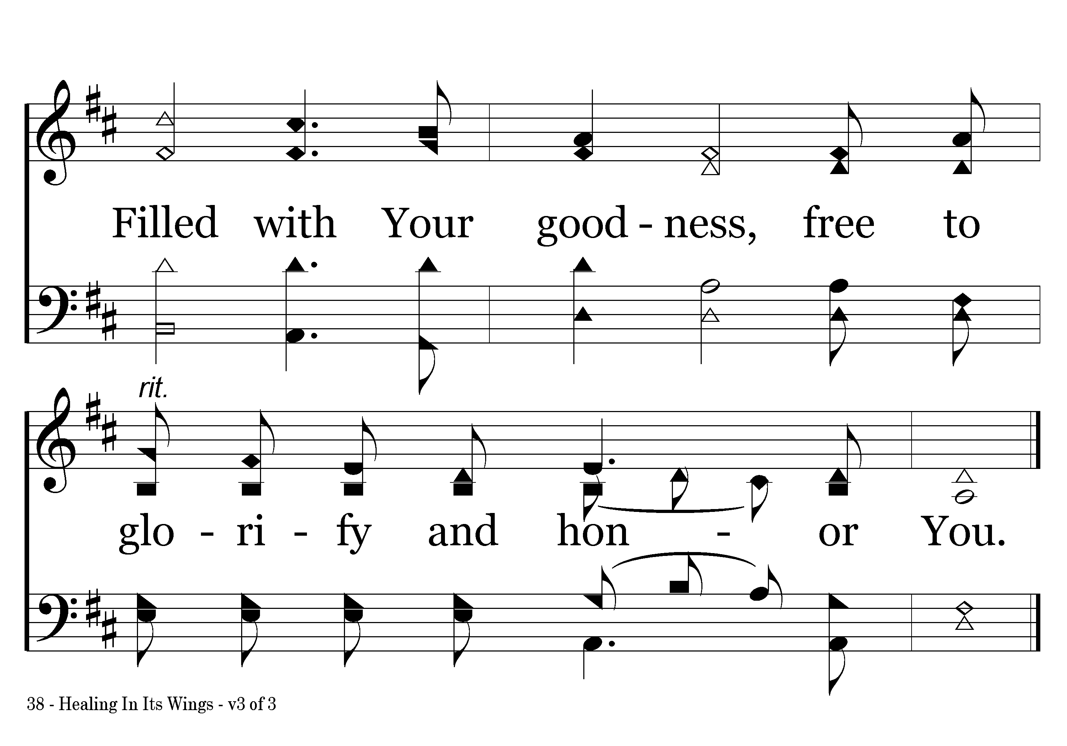
038 - Healing In Its Wings - 3.4
End of Song

